Slide 1
Applications:
The applications of Bt can be in two ways
1. Bt formulations
2. Transgenic plants.
Transgenic plants:
The area devoted to growing transgenic plants expressing insecticidal Cry proteins derived from Bacillus thuringiensis (Bt) is increasing worldwide.
A major concern with the adoption of Bt crops is their potential impact on nontarget organisms including biological control organisms.
Regulatory frameworks should advocate a step-wise (tiered) approach to assess possible nontarget effects of Bt crops.

Slide 2
Transgenic plants:
In 1995, the Environmental Protection Agency (EPA) in USA approved the commercial production and distribution of the Bt crops: corn, cotton, potato, and tobacco.
Currently, the most common Bt crops are corn and cotton. The crystal, referred to as Cry toxins, is proteins formed during sporulation of some Bt strains and aggregate to form crystals.
Such Cry toxins are toxic to specific species of insects belongs to orders: Lepidoptera, Coleoptera, Hymenoptera, Diptera, and Nematoda.
In 2016, the total world area cultivated with genetically modified crops (GM crops) reached about 185 million ha
There is a worldwide controversy about the safety of Bt crops to the environment and mammals. Some researchers support the cultivation of Bt crops depending upon the results of their laboratory and field studies on the safety of such crops.
Others, however, are against Bt crops as they may cause risk to human.

Slide 3
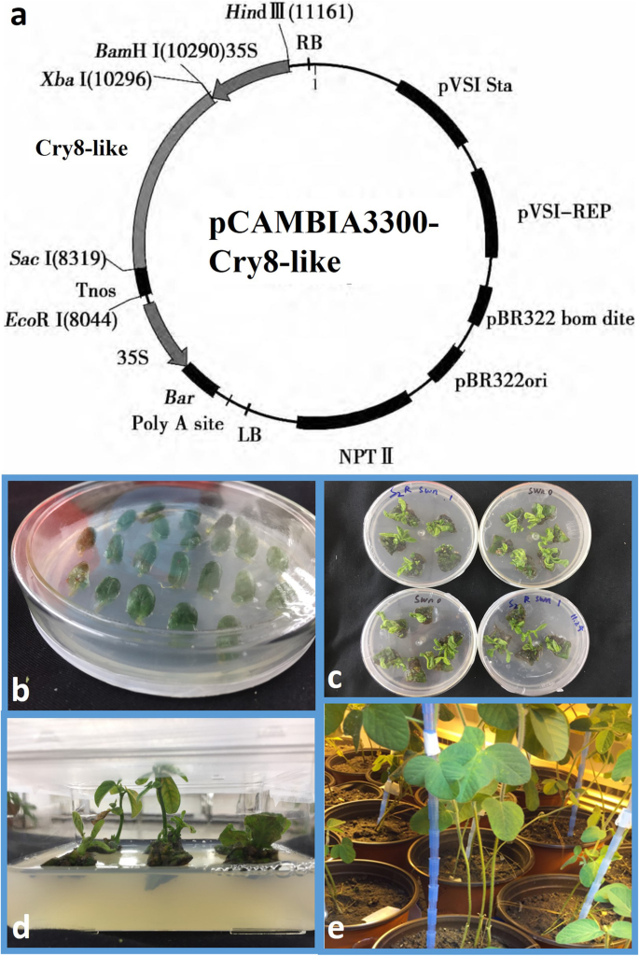

Slide 4
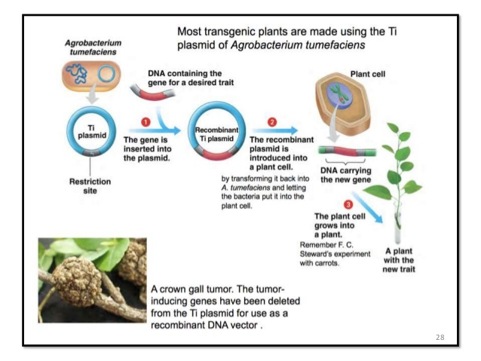

Slide 5
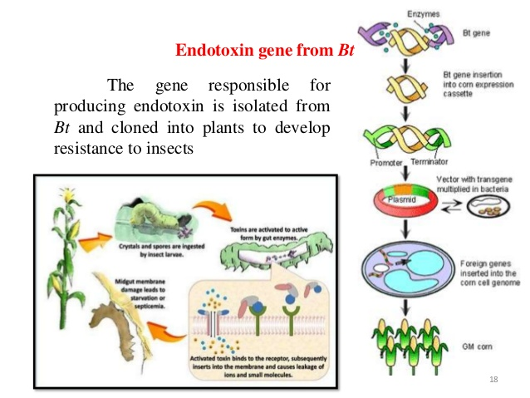

Slide 6
Bt crops:
Advantages of Bt Crops
Following are the major advantages of Bt crops:
It helps in improving the crop yield, thereby, raising the farmer’s income. This results in increased farm production.
They help in controlling soil pollution as the use of synthetic pesticides is reduced.
Bt crops help in protecting beneficial insects.
It can easily feed an increasing population due to increased yields in a short time.
It leads to the production of disease-free crops owing to the reduction of pesticides.
It leads to more productivity in a small area of land.
Disadvantages of Bt Crops
Bt crops have a few disadvantages as well:
Bt crops are costlier than naturally grown crops.
It can disrupt the natural process of gene flow.
The pests might become resistant to the toxins produced by these crops and the crop production might decline.

Slide 7
Can insect pests develop resistance to Bt crops?
The caterpillar pest Helicoverpa zea (also known as cotton bollworm and corn earworm) has evolved resistance to four Bt proteins.
But insects that have developed resistance to Bt toxins can live on undeterred, and that resistance is growing.
We will discuss more in the topic “Microbes in Agrobiotechnology”

Slide 8
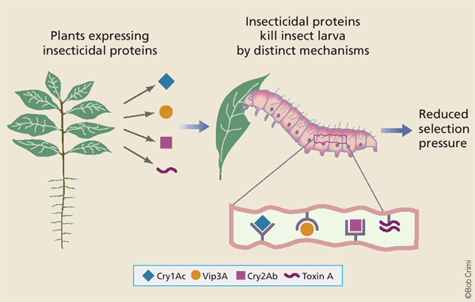

Slide 9
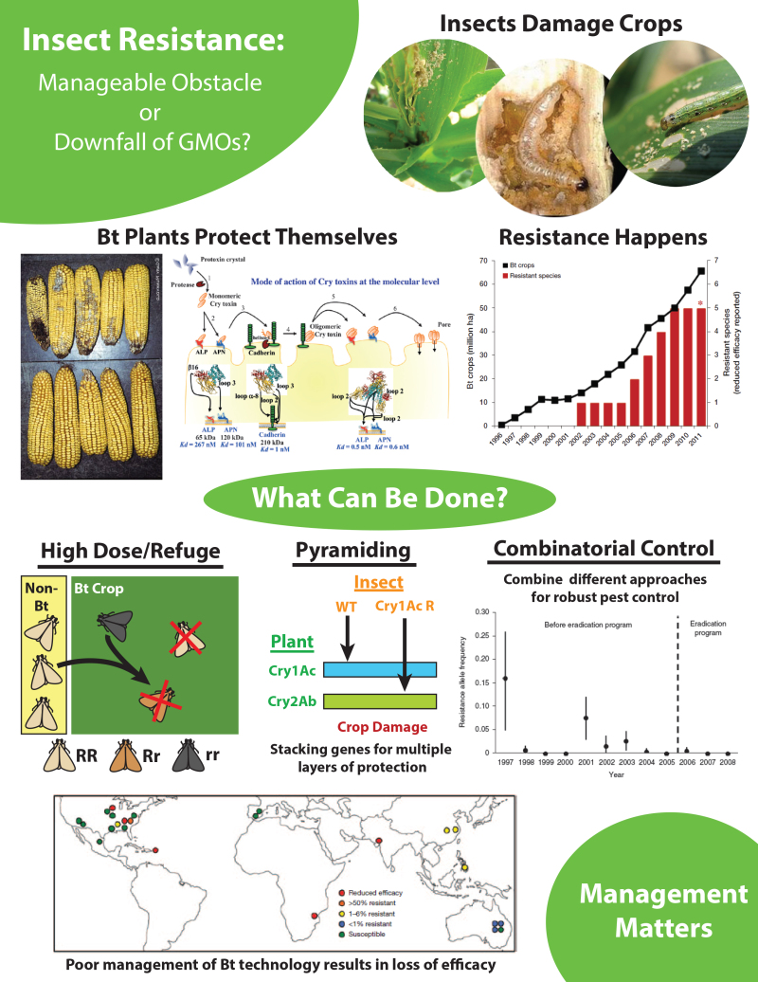

Slide 10
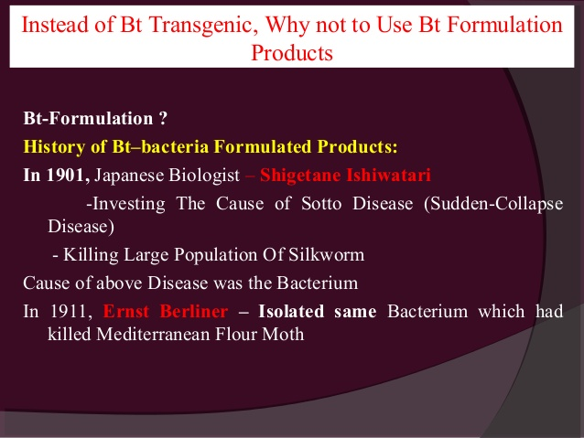
Bt formulations:

Slide 11
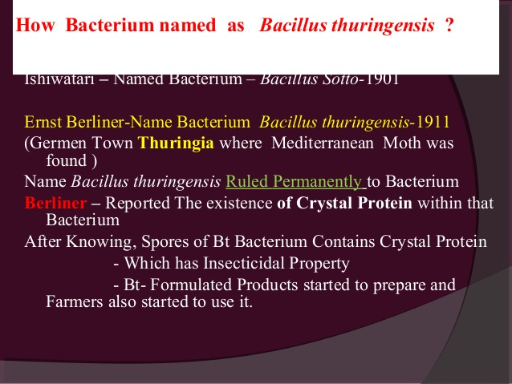

Slide 12
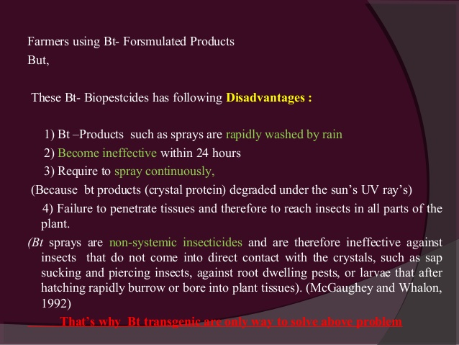

Slide 13
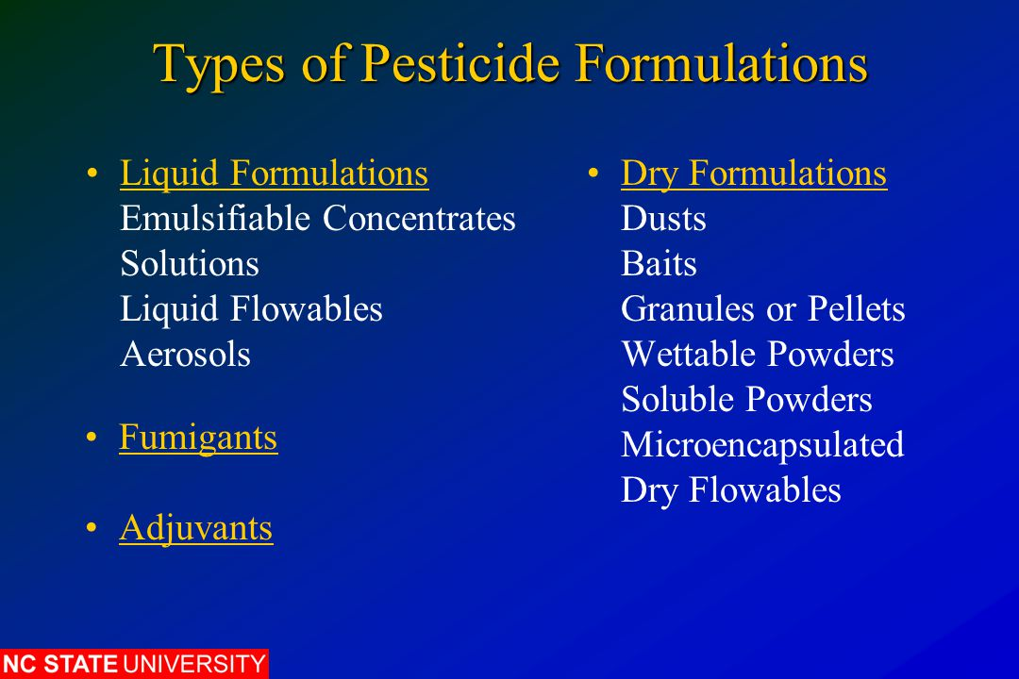

Slide 14
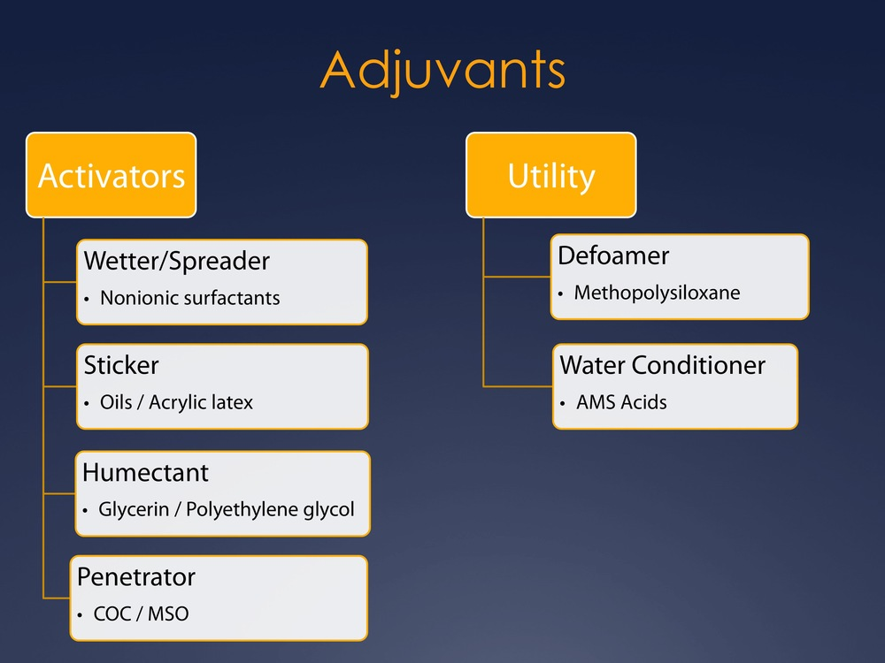

Slide 15
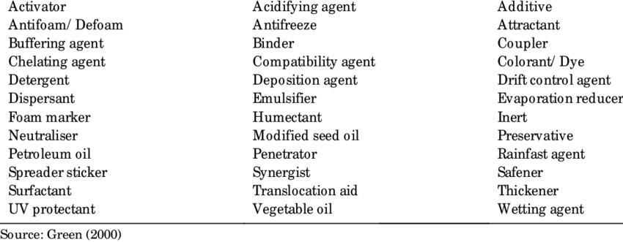

Slide 16
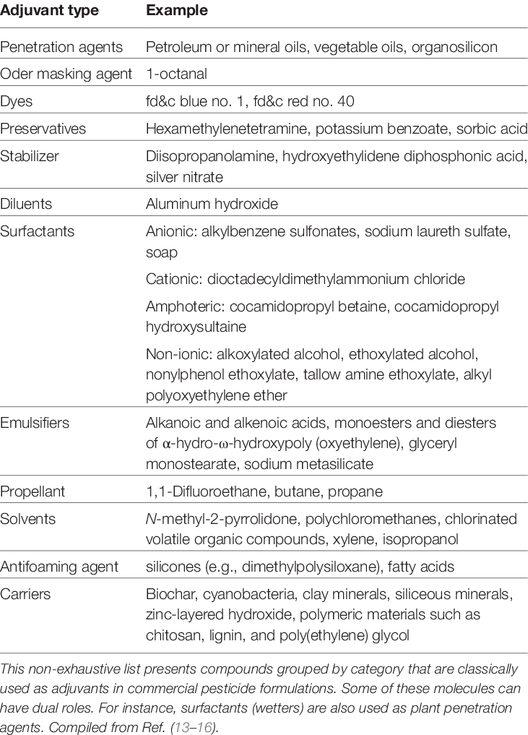

Slide 17
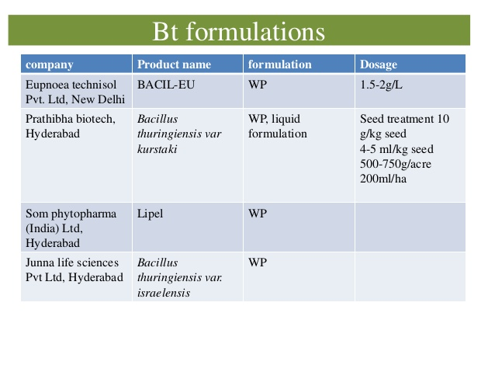

Slide 18
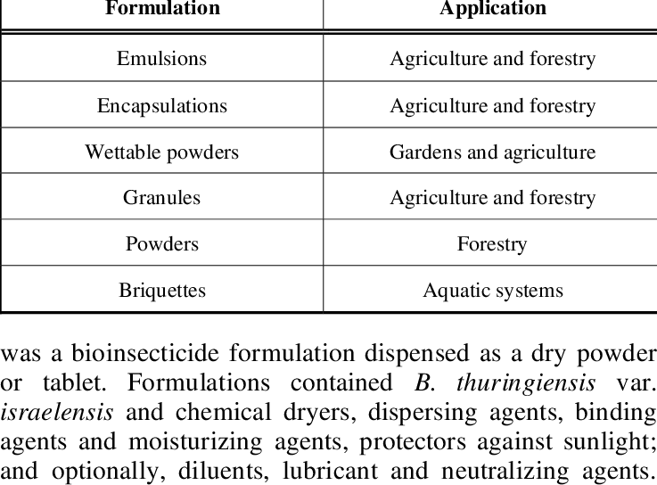

Slide 19
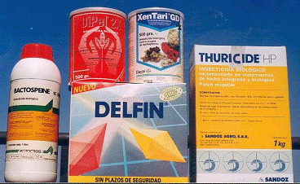

Slide 20
